Slide 1
Data Mining
Data Preprocessing

Slide 2
Data Preprocessing
Data Preprocessing: An Overview
Data Quality
Major Tasks in Data Preprocessing
Data Cleaning
Data Integration
Data Reduction
Data Transformation and Data Discretization
Summary

Slide 3
Data Quality: Why Preprocess the Data?
Data in the real world is dirty
incomplete: lacking attribute values, lacking certain attributes of interest, or containing only aggregate data
e.g., occupation=“ ”
noisy: containing errors or outliers
e.g., Salary=“-10”
inconsistent: containing discrepancies in codes or names
e.g., Age=“42” Birthday=“03/07/1997”
e.g., Was rating “1,2,3”, now rating “A, B, C”
e.g., discrepancy between duplicate records

Slide 4
Why Incomplete?
Mainly from data collection
Attributes of interest may not always be available
e.g. age of a customer
Relevant data may have been considered unimportant at the time of entry
e.g. height of a customer
Malfunctions of data entry equipment
Inconsistent data may have been removed
Do not wish to submit personal information
Might no be applicable for a specific tuple
…

Slide 5
Why Noisy?
Mainly from data collection
Data collection instruments may not be accurate
e.g. measuring wind speed with stopwatch
Human or computer errors occurring at data entry
Errors in data transmission
e.g. network error
Deliberate errors
Data decay
…

Slide 6
Why Inconsistent?
Mainly from data integration
An attribute may have different names in different databases
e.g. customer, cust, and cust_id
A value of an attribute may have different measures in different databases
e.g. 1.75m and 175cm
……

Slide 7
Data Quality
Measures for data quality: A multidimensional view
Accuracy: correct or wrong, accurate or not
Completeness: not recorded, unavailable, …
Consistency: some modified but some not, dangling, …
Timeliness: timely update?
Believability: how trustable the data are correct?
Interpretability: how easily the data can be understood?

Slide 8
Why is Data Preprocessing Important?
No quality data, no quality mining results
How about mining those data directly?
Although most mining routines have some ability of dealing with incomplete or noisy data, they are not always robust
Most mining routines cannot deal with inconsistency
Even without incompleteness, noise, and inconsistency, the size of the data may be too large to mine
Data preprocessing usually occupies about 70% workload in a data mining task

Slide 9
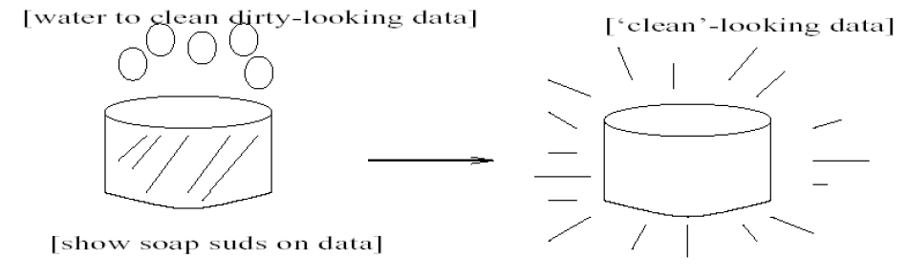
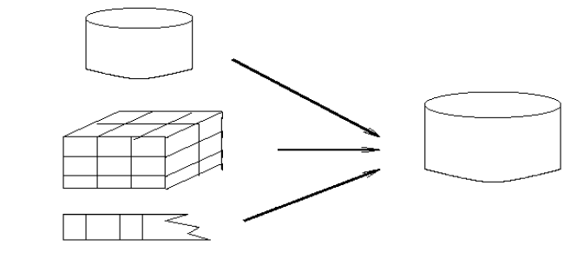
Major Tasks in Data Preprocessing
Data cleaning
Fill in missing values, smooth noisy data, identify or remove outliers, and resolve inconsistencies
Data integration
Integration of multiple databases, data cubes, or files

Slide 10
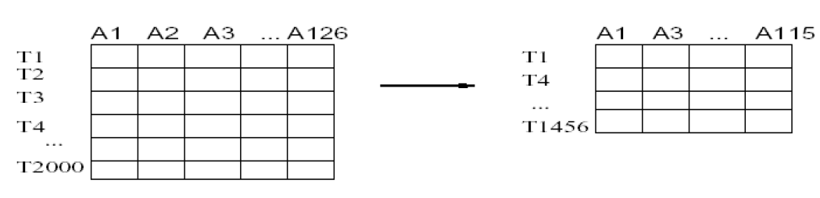
Major Tasks in Data Preprocessing
Data reduction
Obtains reduced representation in volume but produces the same or similar analytical results
Data transformation and data discretization
Normalization and Aggregation

Slide 11
Data Preprocessing
Data Preprocessing: An Overview
Data Quality
Major Tasks in Data Preprocessing
Data Cleaning
Data Integration
Data Reduction
Data Transformation and Data Discretization
Summary

Slide 12
Data Cleaning
Fill in missing values
Identify outliers and smooth out noisy data
Correct inconsistent data

Slide 13
How to Handle Missing Data?
Ignore the tuple: usually done when class label is missing (when doing classification)—not effective when the % of missing values per attribute varies considerably
Fill in the missing value manually: tedious + infeasible?
Fill in it automatically with
a global constant : e.g., “unknown”, a new class?!
the attribute mean
the attribute mean for all samples belonging to the same class: smarter
the most probable value: inference-based such as Bayesian formula or decision tree

Slide 14
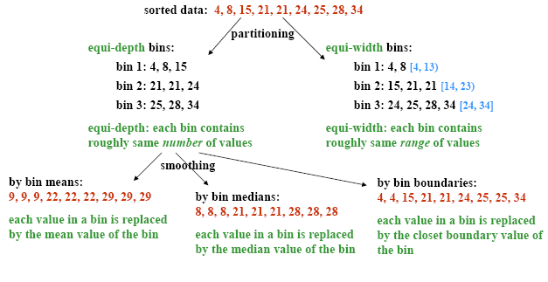
How to Handle Noisy Data?
Binning
first sort data and partition into bins
then one can smooth by bin means, smooth by bin median, smooth by bin boundaries, etc.
smooth a sorted data value by consulting its “neighborhood”
Notes:
Enrich using data integration research!!

Slide 15
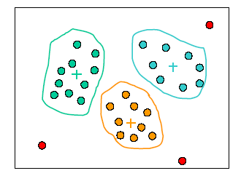
How to Handle Noisy Data?
Clustering
detect and remove outliers
organize similar values into groups or clusters
values falling out of the set of clusters may be regarded as outliers

Slide 16
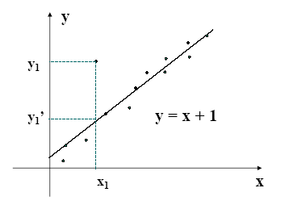
How to Handle Noisy Data?
Regression
smooth by fitting the data into regression functions
values deviate from the expected values for some distance may be regarded as outliers

Slide 17
How to Handle Inconsistent Data?
Some data inconsistencies may be corrected manually using external references
e.g. errors made at data entry may be corrected by performing a paper trace
Knowledge engineering tools may also be used to detect the violation of known data constraints
In general, correcting inconsistent data requires intervention of users

Slide 18
Data Preprocessing
Data Preprocessing: An Overview
Data Quality
Major Tasks in Data Preprocessing
Data Cleaning
Data Integration
Data Reduction
Data Transformation and Data Discretization
Summary

Slide 19
Data Integration
Combine data from multiple sources into a coherent data store
Schema integration
Entity identification problem: How can entities from multiple data sources be “matched up”?
e.g. family name vs. surname
Semantic heterogeneity problem: for the same real world entity, due to differences in representation, scaling, or encoding, attribute values from different sources may be different
e.g. 175cm vs. 1.75m metadata can be used to help schema integration

Slide 20
Data Integration
Handling Redundancy: Redundant data occur often when integration of multiple databases
Object identification: The same attribute or object may have different names in different databases
Derivable data: One attribute may be a “derived” attribute in another table, e.g., annual revenue
Some tuples may be duplicated
Redundant attributes may be able to be detected by correlation analysis and covariance analysis
Careful integration of the data from multiple sources may help reduce/avoid redundancies and inconsistencies and improve mining speed and quality

Slide 21
Correlation Analysis (Nominal Data)
Χ² (chi-square) test
The larger the Χ² value, the more likely the variables are related
The cells that contribute the most to the Χ² value are those whose actual count is very different from the expected count
Correlation does not imply causality
# of hospitals and # of car-theft in a city are correlated
Both are causally linked to the third variable: population

Slide 22
Chi-Square Calculation: An Example
Χ² (chi-square) calculation (numbers in parenthesis are expected counts calculated based on the data distribution in the two categories)
It shows that two attributes are correlated in the group
 | Play chess | Not play chess | Sum (row)
Like science fiction | 250(90) | 200(360) | 450
Not like science fiction | 50(210) | 1000(840) | 1050
Sum(col.) | 300 | 1200 | 1500

Slide 23
Correlation Analysis (Numeric Data)
Correlation coefficient (also called Pearson’s product moment coefficient)
where n is the number of tuples, and are the respective means of A and B, σ_{A} and σ_{B} are the respective standard deviation of A and B, and Σ(a_{i}b_{i}) is the sum of the AB cross-product.
If r_{A,B} > 0, A and B are positively correlated (A’s values increase as B’s). The higher, the stronger correlation.
r_{A,B} = 0: independent; r_{AB} < 0: negatively correlated

Slide 24
Visually Evaluating Correlation
Scatter plots showing the similarity from –1 to 1.

Slide 25
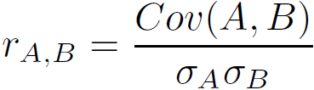
Covariance (Numeric Data)
Covariance is similar to correlation
where n is the number of tuples, and are the respective mean or expected values of A and B, σ_{A} and σ_{B} are the respective standard deviation of A and B.
Positive covariance: If Cov_{A,B} > 0, then A and B both tend to be larger than their expected values.
Negative covariance: If Cov_{A,B} < 0 then if A is larger than its expected value, B is likely to be smaller than its expected value.
Independence: Cov_{A,B} = 0 but the converse is not true:
Some pairs of random variables may have a covariance of 0 but are not independent. Only under some additional assumptions (e.g., the data follow multivariate normal distributions) does a covariance of 0 imply independence
Correlation coefficient:

Slide 26

Co-Variance: An Example
It can be simplified in computation as
Suppose two stocks A and B have the following values in one week: (2, 5), (3, 8), (5, 10), (4, 11), (6, 14).
Question: If the stocks are affected by the same industry trends, will their prices rise or fall together?
E(A) = (2 + 3 + 5 + 4 + 6)/ 5 = 20/5 = 4
E(B) = (5 + 8 + 10 + 11 + 14) /5 = 48/5 = 9.6
Cov(A,B) = (2×5+3×8+5×10+4×11+6×14)/5 − 4 × 9.6 = 4
Thus, A and B rise together since Cov(A, B) > 0.

Slide 27
Data Preprocessing
Data Preprocessing: An Overview
Data Quality
Major Tasks in Data Preprocessing
Data Cleaning
Data Integration
Data Reduction
Data Transformation and Data Discretization
Summary

Slide 28
Data Reduction Strategies
Data reduction: Obtain a reduced representation of the data set that is much smaller in volume but yet produces the same (or almost the same) analytical results
Why data reduction? — A database/data warehouse may store terabytes of data. Complex data analysis may take a very long time to run on the complete data set.
Data reduction strategies
Dimensionality reduction, e.g., remove unimportant attributes
Feature subset selection, feature creation
Wavelet transforms
Principal Components Analysis (PCA)
Numerosity reduction (some simply call it: Data Reduction)
Regression and Log-Linear Models
Histograms, clustering, sampling
Data cube aggregation
Data Compression

Slide 29
Data Reduction 1: Dimensionality Reduction
Curse of dimensionality
When dimensionality increases, data becomes increasingly sparse
Density and distance between points, which is critical to clustering, outlier analysis, becomes less meaningful
The possible combinations of subspaces will grow exponentially
Dimensionality reduction
Avoid the curse of dimensionality
Help eliminate irrelevant features and reduce noise
Reduce time and space required in data mining
Allow easier visualization
Dimensionality reduction techniques
Supervised and nonlinear techniques (e.g., feature selection)
Wavelet transforms
Principal Component Analysis
Notes:
29

Slide 30
Attribute Subset Selection
A way to reduce dimensionality of data
Redundant attributes
Duplicate much or all of the information contained in one or more other attributes
E.g., purchase price of a product and the amount of sales tax paid
Irrelevant attributes
Contain no information that is useful for the data mining task at hand
E.g., students' ID is often irrelevant to the task of predicting students' GPA

Slide 31
Attribute Subset Selection
To find a minimum set of attributes such that the resulting probability distribution of the data classes is as close as possible to the original distribution obtained using all the attributes
Exhaustive search is usually prohibitively expensive, heuristic methods are commonly used
The attributes are typically selected using relevance measures such as information gain
There are 2^{d} possible attribute combinations of d attributes
Typical heuristic attribute selection methods:
Best single attribute under the attribute independence assumption: choose by significance tests

Slide 32
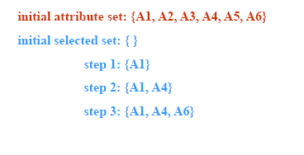
Heuristic Search in Attribute Selection
Best step-wise feature selection:
The best single-attribute is picked first
Then next best attribute condition to the first, …

Slide 33
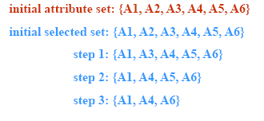
Heuristic Search in Attribute Selection
Step-wise attribute elimination:
Repeatedly eliminate the worst attribute

Slide 34
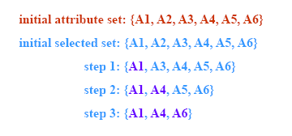
Heuristic Search in Attribute Selection
Best combined attribute selection and elimination
Select the best of the original attributes and eliminate the worst of the remaining original attributes

Slide 35
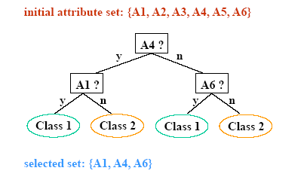
Heuristic Search in Attribute Selection
Optimal branch and bound:
Use attribute elimination and backtracking
Decision tree induction
Train a decision tree
Remove the attributes that have not appeared in the tree

Slide 36
Attribute Creation (Feature Generation)
Create new attributes (features) that can capture the important information in a data set more effectively than the original ones
Three general methodologies
Attribute extraction
Domain-specific
Mapping data to new space (see: data reduction)
E.g., Fourier transformation, wavelet transformation, manifold approaches (not covered)
Attribute construction
Combining features (see: discriminative frequent patterns in Chapter 7) Data discretization
36
Notes:
36

Slide 37
What Is Wavelet Transform?
Data are transformed to preserve relative distance between objects at different levels of resolution
Allow natural clusters to become more distinguishable
Used for image compression
Notes:
37

Slide 38
Wavelet Transformation
Compressed approximation: store only a small fraction of the strongest of the wavelet coefficients
Similar to discrete Fourier transform (DFT), but better lossy compression, localized in space
Method:
Length, L, must be an integer power of 2 (padding with 0’s, when necessary)
Each transform has 2 functions: smoothing, difference
Applies to pairs of data, resulting in two set of data of length L/2
Applies two functions recursively, until reaches the desired length
Notes:
38

Slide 39
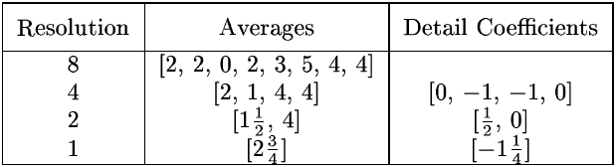
Wavelet Decomposition
Wavelets: A math tool for space-efficient hierarchical decomposition of functions
S = [2, 2, 0, 2, 3, 5, 4, 4] can be transformed to S^ = [2³/₄, -1¹/₄, ¹/₂, 0, 0, -1, -1, 0]
Compression: many small detail coefficients can be replaced by 0’s, and only the significant coefficients are retained
Notes:
39

Slide 40
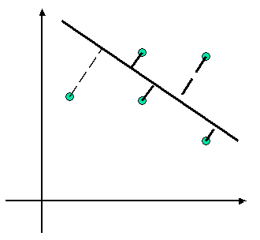
Principal Component Analysis (Steps)
Try to reserve the most variance among data
Search for d number of D-dimensional orthogonal vectors that can best be used to represent the data (d << D)
Each original data is a linear combination of the d principal components
An example of reducing 2-d data to 1-d with PCA. Green dots denote 2-d data points. The goal of PCA is to find a line such that the average distance between the projections of the data points on the line is the maximal, that is, the differences between the data points are reserved at most

Slide 41
Data Reduction 2: Numerosity Reduction
Reduce data volume by choosing alternative, smaller forms of data representation
Parametric methods (e.g., regression)
Assume the data fits some model, estimate model parameters, store only the parameters, and discard the data (except possible outliers)
Ex.: Log-linear models—obtain value at a point in m-D space as the product on appropriate marginal subspaces
Non-parametric methods
Do not assume models
Major families: histograms, clustering, sampling, …

Slide 42
Histogram Analysis
Divide data into buckets and store average (sum) for each bucket
Partitioning rules:
Equal-width: equal bucket range
Equal-frequency (or equal-depth)

Slide 43
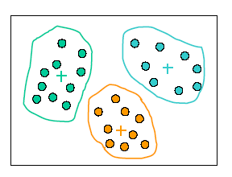
Clustering
Partition the objects into clusters, so that objects within a cluster are similar to each other while dissimilar to objects in other clusters
The quality of a cluster may be measured by:
diameter: the maximum distance between any two objects in the cluster
centroid distance: the average distance of each cluster object from the cluster centroid

Slide 44
Sampling
Sampling: obtaining a small sample s to represent the whole data set N
Allow a mining algorithm to run in complexity that is potentially sub-linear to the size of the data
Key principle: Choose a representative subset of the data
Simple random sampling may have very poor performance in the presence of skew
Develop adaptive sampling methods, e.g., stratified sampling:

Slide 45
Types of Sampling
Simple random sampling
There is an equal probability of selecting any particular item
Sampling without replacement
Once an object is selected, it is removed from the population
Sampling with replacement
A selected object is not removed from the population
Cluster sample:
Tuples are grouped into M mutually disjoint clusters
An SRS of s clusters can be obtained, where s<M
Stratified sampling:
Partition the data set, and draw samples from each partition (proportionally, i.e., approximately the same percentage of the data)
Used in conjunction with skewed data

Slide 46
Sampling: With or without Replacement
SRSWOR
(simple random
sample without
replacement)
SRSWR
Raw Data

Slide 47
Data Cube Aggregation
The lowest level of a data cube (base cuboid)
The aggregated data for an individual entity of interest
E.g., a customer in a phone calling data warehouse
Multiple levels of aggregation in data cubes
Further reduce the size of data to deal with
Reference appropriate levels
Use the smallest representation which is enough to solve the task
Queries regarding aggregated information should be answered using data cube, when possible
Notes:
47

Slide 48
Data Reduction 3: Data Compression
String compression
There are extensive theories and well-tuned algorithms
Typically lossless, but only limited manipulation is possible without expansion
Audio/video compression
Typically lossy compression, with progressive refinement
Sometimes small fragments of signal can be reconstructed without reconstructing the whole
Time sequence is not audio
Typically short and vary slowly with time
Dimensionality and numerosity reduction may also be considered as forms of data compression
Notes:
48

Slide 49
Data Preprocessing
Data Preprocessing: An Overview
Data Quality
Major Tasks in Data Preprocessing
Data Cleaning
Data Integration
Data Reduction
Data Transformation and Data Discretization
Summary

Slide 50
Data Transformation
A function that maps the entire set of values of a given attribute to a new set of replacement values s.t. each old value can be identified with one of the new values
Methods
Smoothing: Remove noise from data
Attribute/feature construction
New attributes constructed from the given ones
Aggregation: Summarization, data cube construction
Normalization: Scaled to fall within a smaller, specified range
min-max normalization
z-score normalization
normalization by decimal scaling
Discretization: Concept hierarchy climbing
Notes:
50

Slide 51
Normalization
Min-max normalization: to [new_min_{A}, new_max_{A}]
Ex. Let income range $12,000 to $98,000 normalized to [0.0, 1.0]. Then $73,000 is mapped to
Z-score normalization (μ: mean, σ: standard deviation):
Ex. Let μ = 54,000, σ = 16,000. Then
Normalization by decimal scaling
Where j is the smallest integer such that Max(|ν’|) < 1

Slide 52
Discretization
Discretization: Divide the range of a continuous attribute into intervals
Interval labels can then be used to replace actual data values
Reduce data size by discretization
Supervised vs. unsupervised
Split (top-down) vs. merge (bottom-up)
Discretization can be performed recursively on an attribute
Prepare for further analysis, e.g., classification

Slide 53
Data Discretization Methods
Typical methods: All the methods can be applied recursively
Binning (unsupervised, top-down split)
Histogram analysis (unsupervised, top-down split)
Clustering analysis (unsupervised, top-down split or bottom-up merge)
Decision-tree analysis (supervised, top-down split)
Correlation (e.g., χ²) analysis (unsupervised, bottom-up merge)
Notes:
53

Slide 54
Discretization by Classification & Correlation Analysis
Classification (e.g., decision tree analysis)
Supervised: Given class labels, e.g., cancerous vs. benign
Top-down, recursive split
Details to be covered in Chapter 7
Correlation analysis (e.g., Chi-merge: χ²-based discretization)
Supervised: use class information
Bottom-up merge: find the best neighboring intervals (those having similar distributions of classes, i.e., low χ² values) to merge
Merge performed recursively, until a predefined stopping condition
Notes:
54

Slide 55
Concept Hierarchy Generation
Concept hierarchy organizes concepts (i.e., attribute values) hierarchically and is usually associated with each dimension in a data warehouse
Concept hierarchies facilitate drilling and rolling in data warehouses to view data in multiple granularity
Concept hierarchy formation: Recursively reduce the data by collecting and replacing low level concepts (such as numeric values for age) by higher level concepts (such as youth, adult, or senior)
Concept hierarchies can be explicitly specified by domain experts and/or data warehouse designers
Concept hierarchy can be automatically formed for both numeric and nominal data. For numeric data, use discretization methods shown.

Slide 56
Concept Hierarchy Generation for Nominal Data
Specification of a partial/total ordering of attributes explicitly at the schema level by users or experts
street < city < state < country
Specification of a hierarchy for a set of values by explicit data grouping
{Urbana, Champaign, Chicago} < Illinois
Specification of only a partial set of attributes
E.g., only street < city, not others
Automatic generation of hierarchies (or attribute levels) by the analysis of the number of distinct values
E.g., for a set of attributes: {street, city, state, country}

Slide 57
Automatic Concept Hierarchy Generation
Some hierarchies can be automatically generated based on the analysis of the number of distinct values per attribute in the data set
The attribute with the most distinct values is placed at the lowest level of the hierarchy
Exceptions, e.g., weekday, month, quarter, year
country
15 distinct values
province_or_ state
365 distinct values
city
3567 distinct values
street
674,339 distinct values

Slide 58
Data Preprocessing
Data Preprocessing: An Overview
Data Quality
Major Tasks in Data Preprocessing
Data Cleaning
Data Integration
Data Reduction
Data Transformation and Data Discretization
Summary

Slide 59
Summary
Data quality: accuracy, completeness, consistency, timeliness, believability, interpretability
Data cleaning: e.g. missing/noisy values, outliers
Data integration from multiple sources:
Entity identification problem
Remove redundancies
Detect inconsistencies
Data reduction
Dimensionality reduction
Numerosity reduction
Data compression
Data transformation and data discretization
Normalization
Concept hierarchy generation

Slide 60
Reading Material
Class Lecture
Text Book: Chapter 3

Slide 61
Acknowledgements
These slides contain material developed and copyright by:
Jiawei Han (UIUC) (CS412)
Yizhou Sun (Northeastern University) (CS6220)
Zhi-Hua Zhou (Nanjing University)

Slide 62
The End

